Slide 1


INSTITUTE : UIE
DEPARTMENT : CSE
Bachelor of Engineering (Computer Science & Engineering)
WEB AND MOBILE SECURITY (Professional Elective-I)
(20CST/IT-333)
TOPIC OF PRESENTATION:
cross-site scripting, SQL injection
DISCOVER . LEARN . EMPOWER

Slide 2
Lecture Objectives
In this lecture, we will discuss:
Introduction to cross-site scripting, SQL injection

Slide 3
Cross-Site Scripting (XSS)
XSS is a very common vulnerability
Would be vulnerability of the decade except SQL injections are often far more serious
XSS is used for a client to attack another client, not to attack a server
An XSS vulnerability is as simple as echoing back user-input without sanitizing
Ex: You submit: “XYZ!!(2” to a search engine and it replies with “XYZ!!(2 no results found”

Slide 4
“Security Context”
We define a security context to be the set of rules that govern how cookies are handled between domains
Users might have several contexts active at the same time
Ex: An unexpired session token with a bank sitting in another browser window (logout or browser death usually purges these tokens, but users will often neglect to do either)

Slide 5
XSS
The idea of XSS is for an attacker to inject malicious javascript into a security context that it does not own
And, as we know, this means things like session tokens can be sent anywhere we like

Slide 6
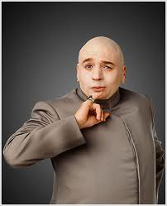
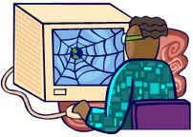
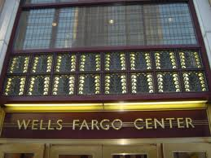
user connects to evil site
javascript executes as if
from bank; tokens stolen
Link to bank with malicious
javascript given as parameter
malicious javascript
reflected back to user with bank’s security context
Typically called
“reflected” XSS

Slide 7
Demo on moxie
Visit stateful.php to establish highly valuable session ID
View xss.php behavior
Look at ~drevil on moxie
Note the warm innocent feel of the page
View source on this page (note the encodings)
Examine steal.php
Click on link on drevil’s homepage
Look in /tmp/stolen.txt

Slide 8
Stored XSS
Stored XSS is very similar
Instead of using a reflection bug, the attacker stores javascript in a place where the victim is likely to read it (and thereby execute it)
It’s usually the server’s responsibility to sanitize user input before storing it
Consider a public forum where various users post their thoughts
And their exploit code…
Stored XSS is usually considered more serious
No need to induce the user to establish a session then visit drevil’s site, which can be hard some times

Slide 9
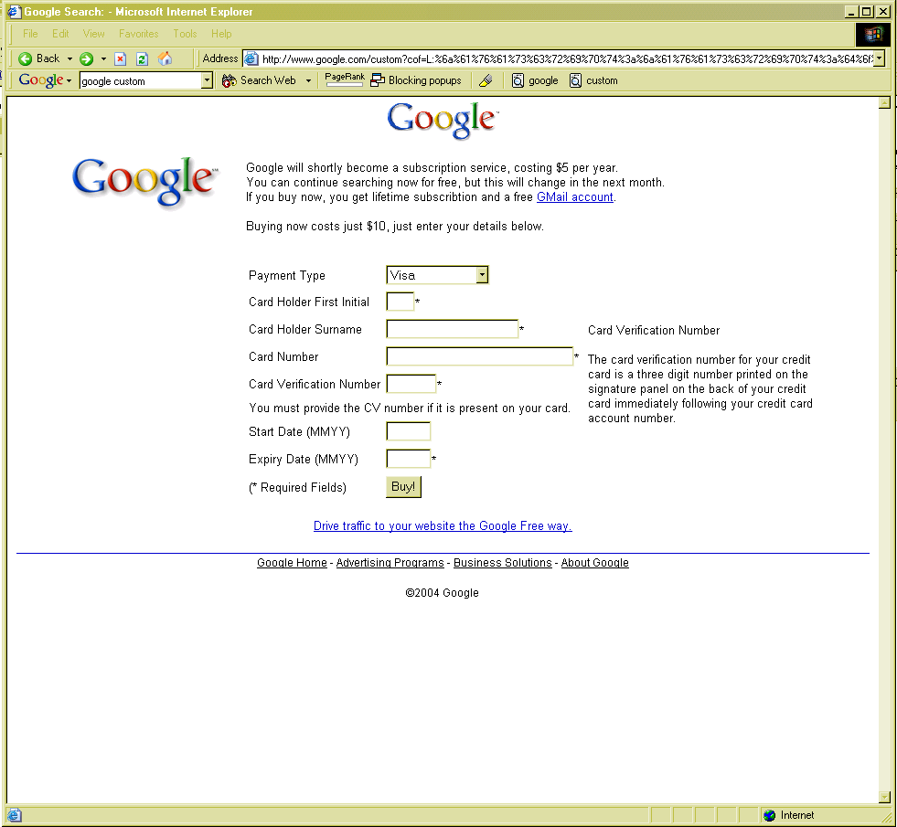
Note proper domain name
SSL would be enabled, if this were an SSL site

Slide 10
Samy XSS worm
Oct, 2005: myspace had an XSS vulnerability
They used <script> filters, but 19-yr old Samy Kamkar found a way to bypass all of them
He built an AJAX app so that every view of his profile added him as a friend and posted “…and most of all, Samy is my hero” to their page
He also had the worm install itself so that any viewer of the page would propagate the worm

Slide 11
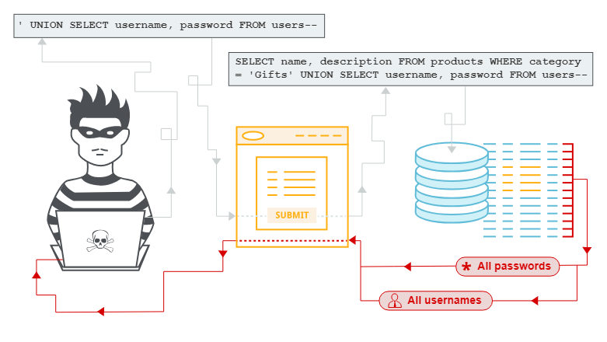
SQL injection

Slide 12
SQL injection (SQLi)
SQL injection (SQLi) is a web security vulnerability that allows an attacker to interfere with the queries that an application makes to its database. It generally allows an attacker to view data that they are not normally able to retrieve. This might include data belonging to other users, or any other data that the application itself is able to access. In many cases, an attacker can modify or delete this data, causing persistent changes to the application's content or behavior.
In some situations, an attacker can escalate an SQL injection attack to compromise the underlying server or other back-end infrastructure, or perform a denial-of-service attack. Some common SQL injection examples include:
Retrieving hidden data, where you can modify an SQL query to return additional results.
Subverting application logic, where you can change a query to interfere with the application's logic.
UNION attacks, where you can retrieve data from different database tables.
Examining the database, where you can extract information about the version and structure of the database.
Blind SQL injection, where the results of a query you control are not returned in the application's responses.
Retrieving hidden data

Slide 13
Impact
Therefore, a successful SQL Injection attack can have very serious consequences.
Attackers can use SQL Injections to find the credentials of other users in the database. They can then impersonate these users. The impersonated user may be a database administrator with all database privileges.
SQL lets you select and output data from the database. An SQL Injection vulnerability could allow the attacker to gain complete access to all data in a database server.
SQL also lets you alter data in a database and add new data. For example, in a financial application, an attacker could use SQL Injection to alter balances, void transactions, or transfer money to their account.
You can use SQL to delete records from a database, even drop tables. Even if the administrator makes database backups, deletion of data could affect application availability until the database is restored. Also, backups may not cover the most recent data.
In some database servers, you can access the operating system using the database server. This may be intentional or accidental. In such case, an attacker could use an SQL Injection as the initial vector and then attack the internal network behind a firewall.

Slide 14
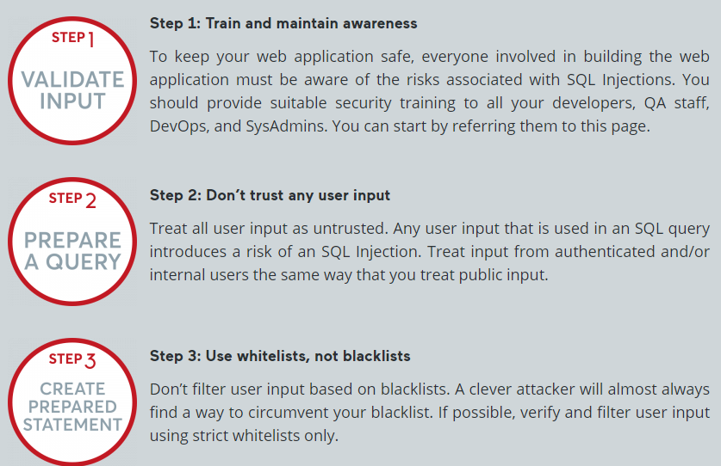
How to Prevent SQL Injections (SQLi)

Slide 15
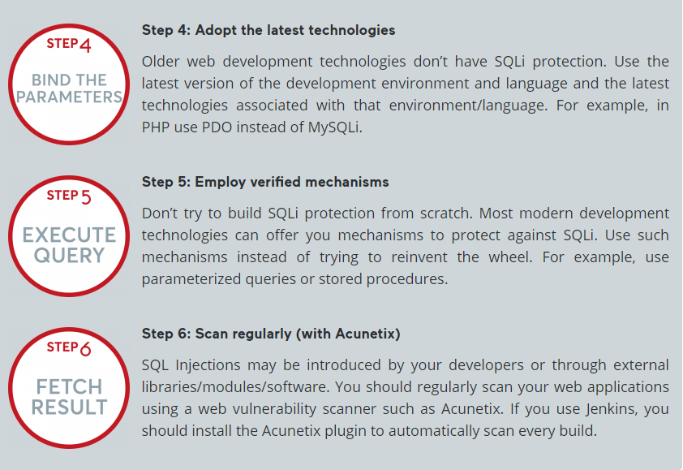
How to Prevent SQL Injections (SQLi)

Slide 16
References:
Books:
Web Design With HTML, CSS, JavaScript and jQuery Set, 1st Edition, by Jon Duckett.
Hacking Exposed Web Applications, 3rd edition, Joel Scambray, Vincent Liu, Caleb Sima, Released October 2010, Publisher(s): McGraw-Hill
Video Lectures :
https://www.youtube.com/watch?v=KUPlmDSDZLc
https://www.youtube.com/watch?v=NQ_WIyu9fUQ&t=868s
Reference Links:
https://portswigger.net/web-security/sql-injection
https://www.imperva.com/learn/application-security/sql-injection-sqli/
https://owasp.org/www-community/attacks/xss/
https://www.acunetix.com/websitesecurity/cross-site-scripting/

Slide 17

THANK YOU

